Slide 1
MINi PROJECT
E-COMMERCE WEBSITE
Amit Parihar
Prashant Goswami
Arun Verma
Priyansh Goyal
Presented By:

Slide 2
INTRODUCTION
E-COMMERCE WEBSITE
Ecommerce is the buying and selling of goods and services over the Internet.
It is conducted over computers, tablets, smartphones, and other smart devices.
Almost anything can be purchased through ecommerce today; for this reason, ecommerce is often highly competitive.
Ecommerce operates in several market segments including business-to-business,
business-to-consumer, consumer-to-consumer, and consumer-to-business.
Top Examples of Ecommerce. There are some pretty major examples of ecommerce businesses that have made it big, including Amazon, Flipkart, eBay, and Myntra.

Slide 3
USES
Online Shopping: The primary purpose of e-commerce websites is to facilitate online buying and selling of goods and services. Customers can browse products, compare prices, read reviews, and make purchases conveniently from anywhere.
Marketing and Promotion: E-commerce websites serve as a platform for marketing and promotional activities. Businesses can run targeted campaigns, offer discounts, and engage customers through various strategies to boost sales.
Payment and Transactions: These platforms offer secure payment gateways, allowing customers to make transactions using various payment methods, such as credit/debit cards, digital wallets, or other online payment systems.

Slide 4






Save Money
24/7 Support
Online Order
Happy Sell
Free Shipping
Promotions

Slide 5



Software Requirements
HTML ( Hypertext Markup Language )
CSS ( Cascading Style Sheets )
JavaScript

Slide 6
Modules
1
STORE
2
CART
3
SIGN UP
ECOMMERCE
WEBSITE
4
LOGIN
5
ORDERS
6
LOGOUT

Slide 7
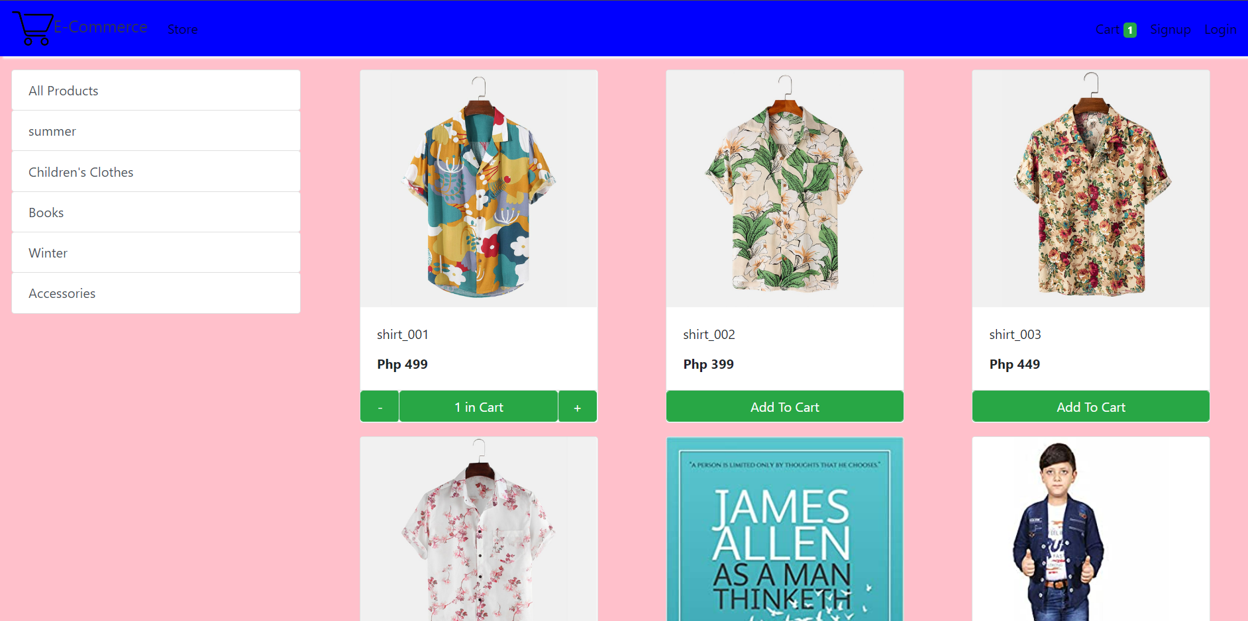
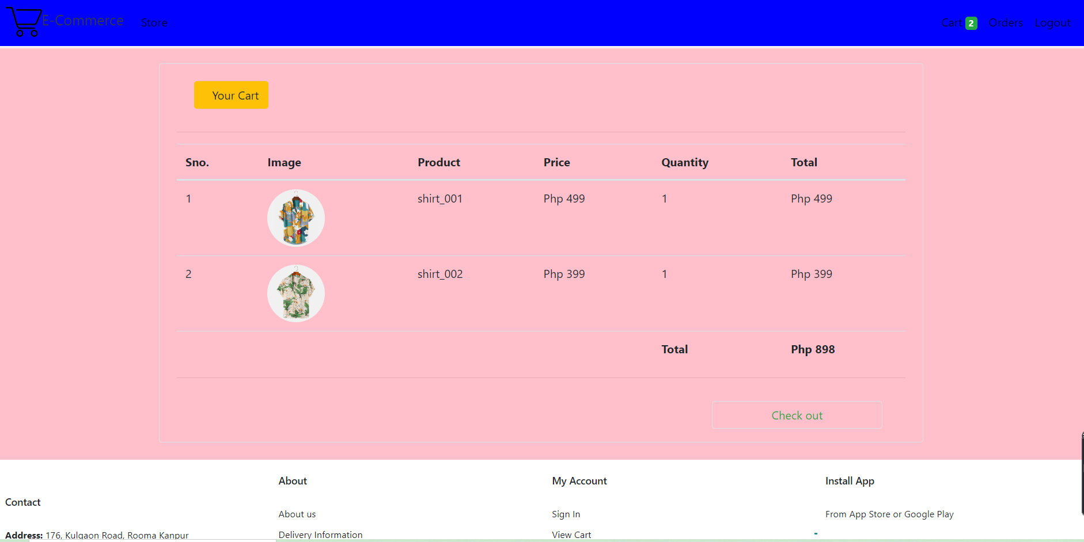
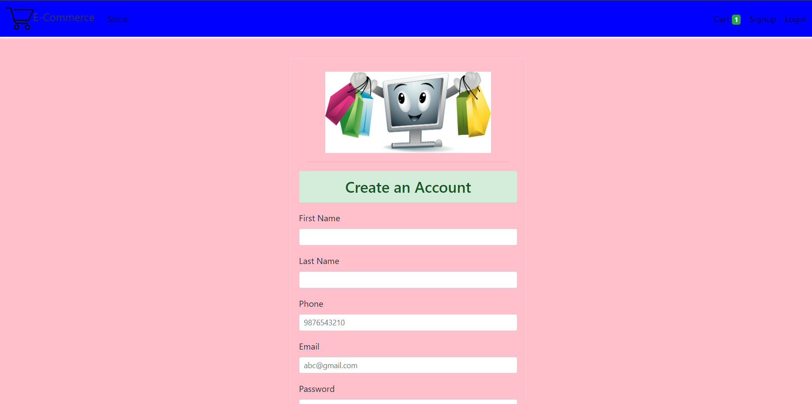
1
STORE
2
CART
3
SIGN UP

Slide 8
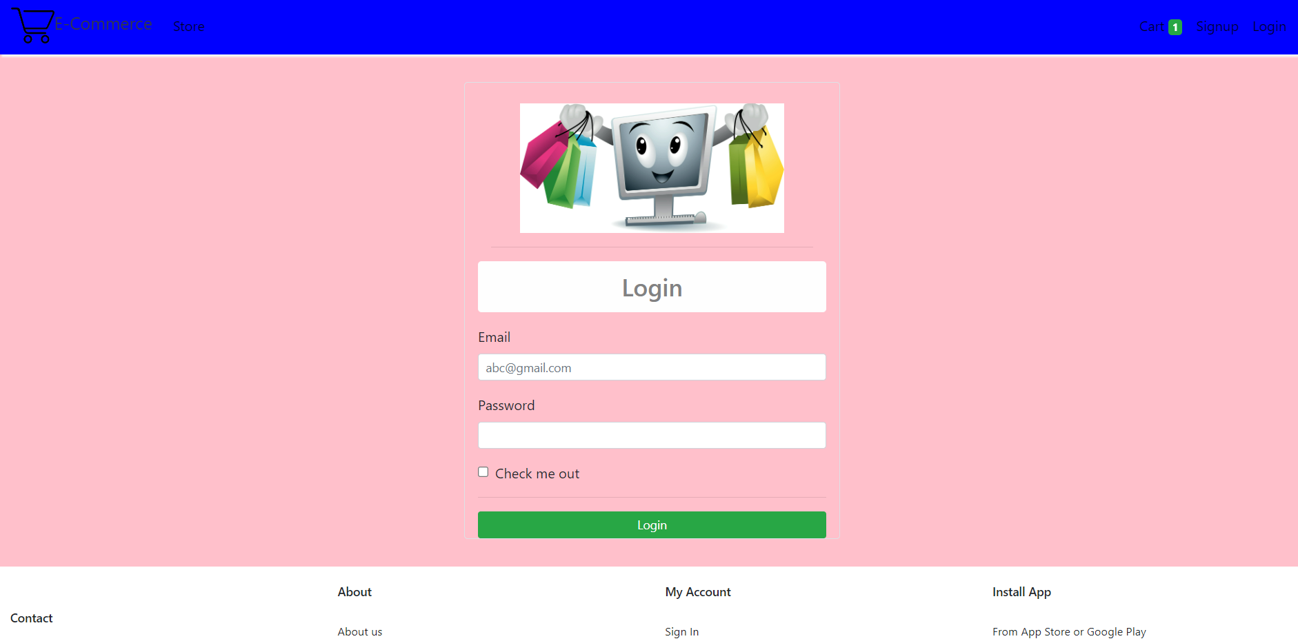
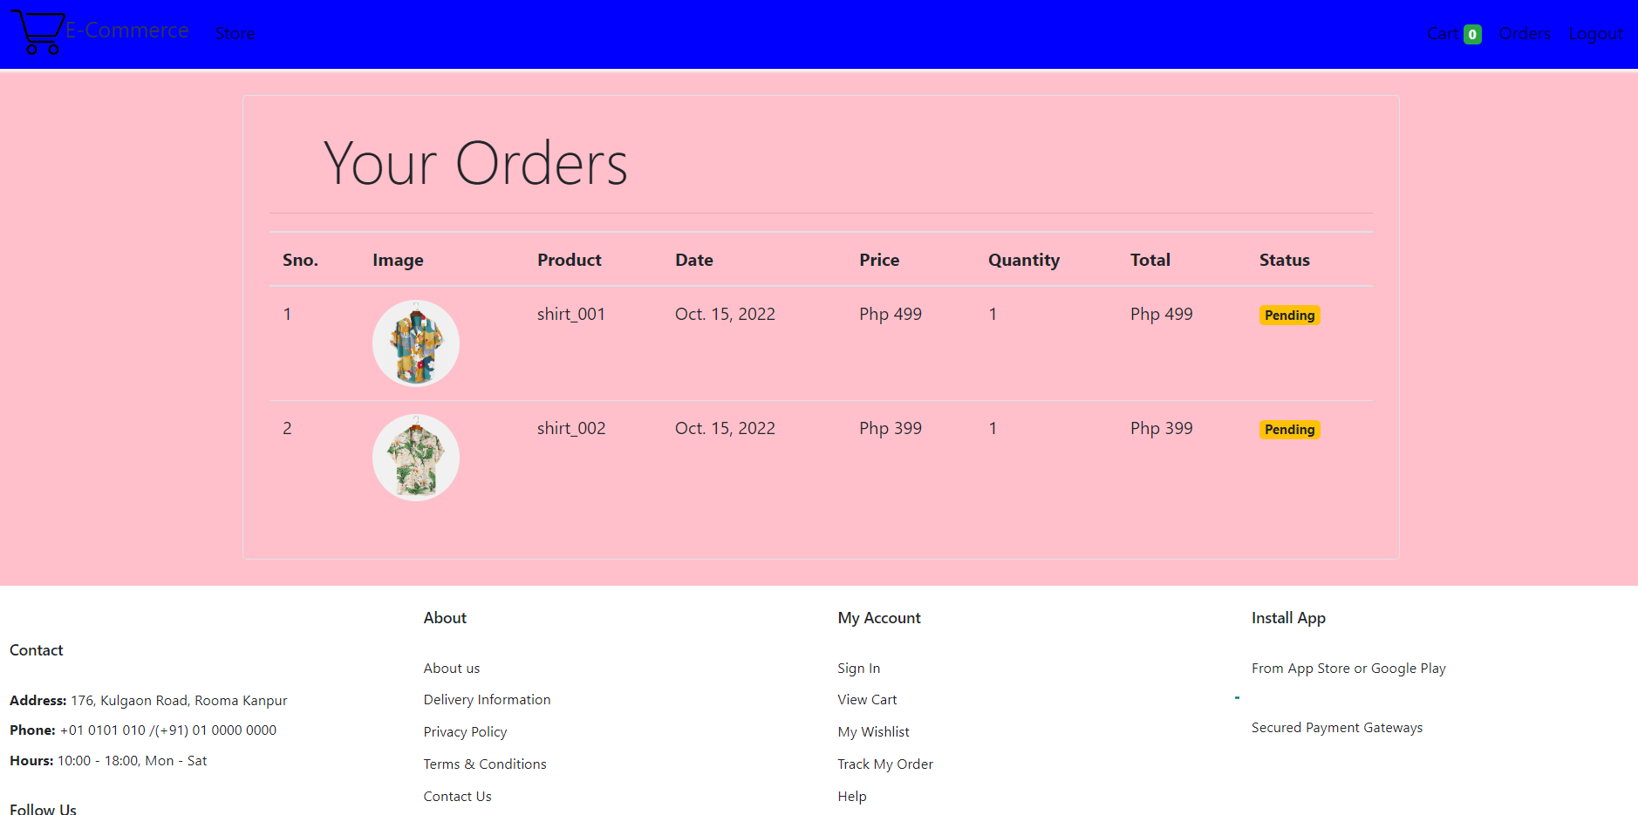
4
LOGIN
5
ORDERS

Slide 9
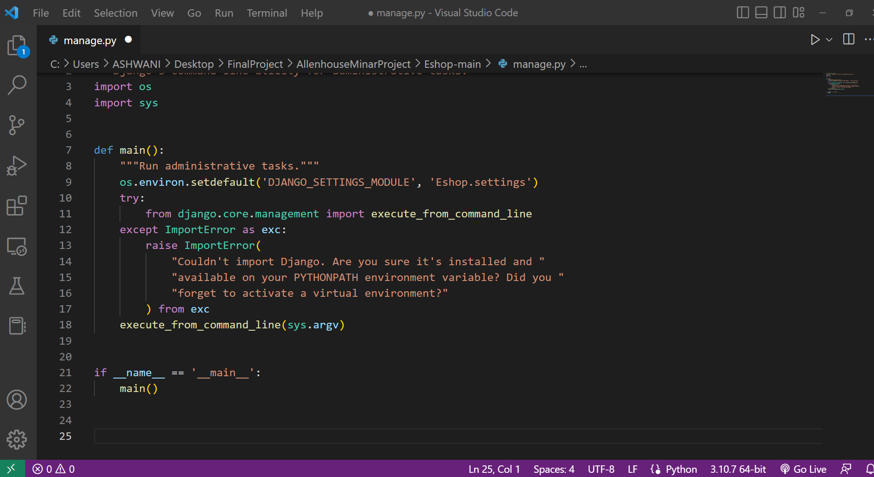
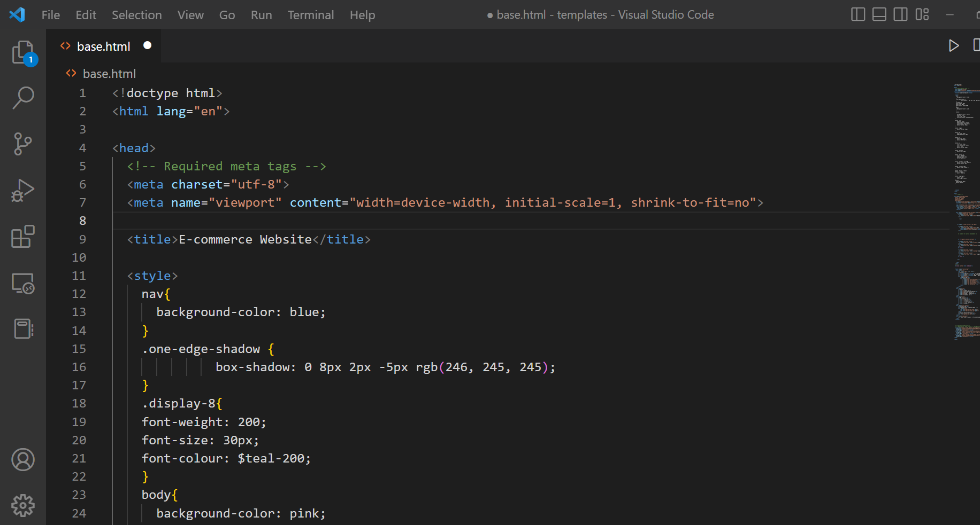
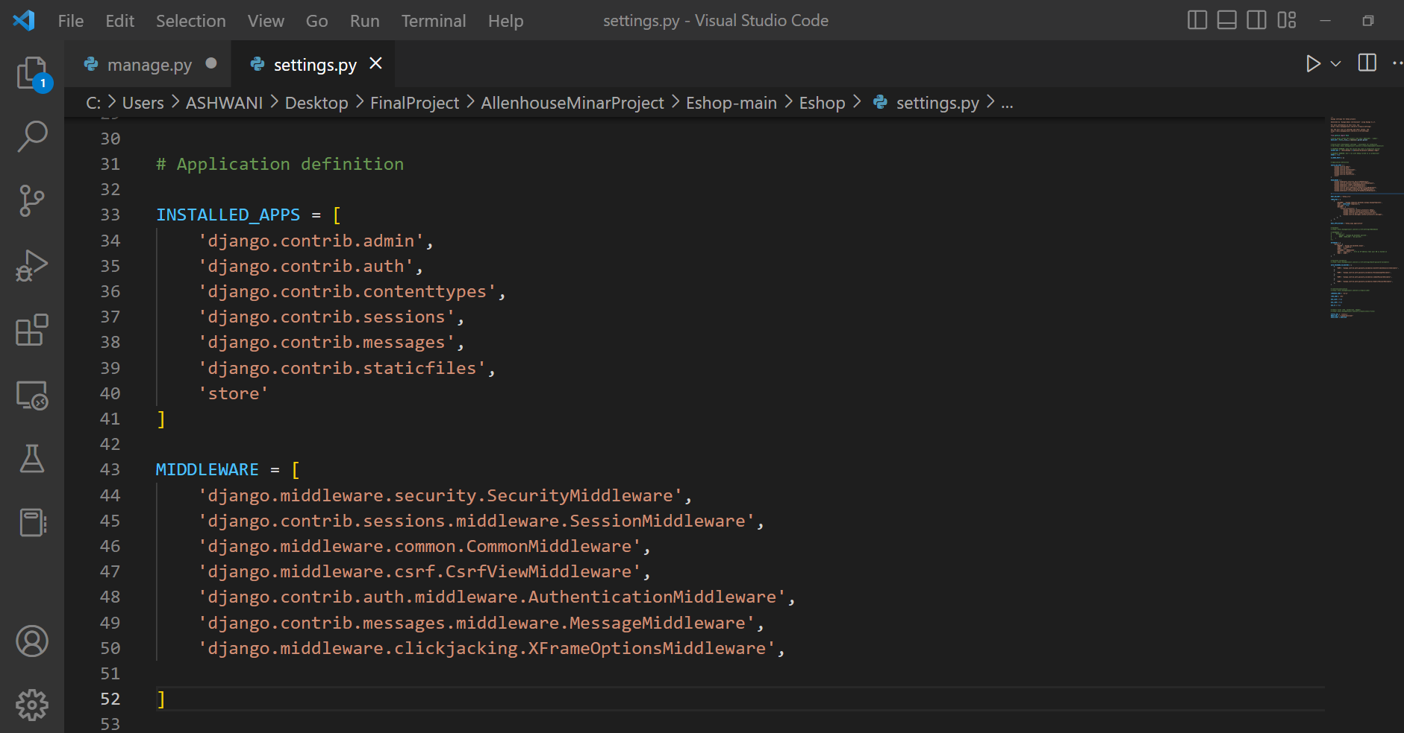
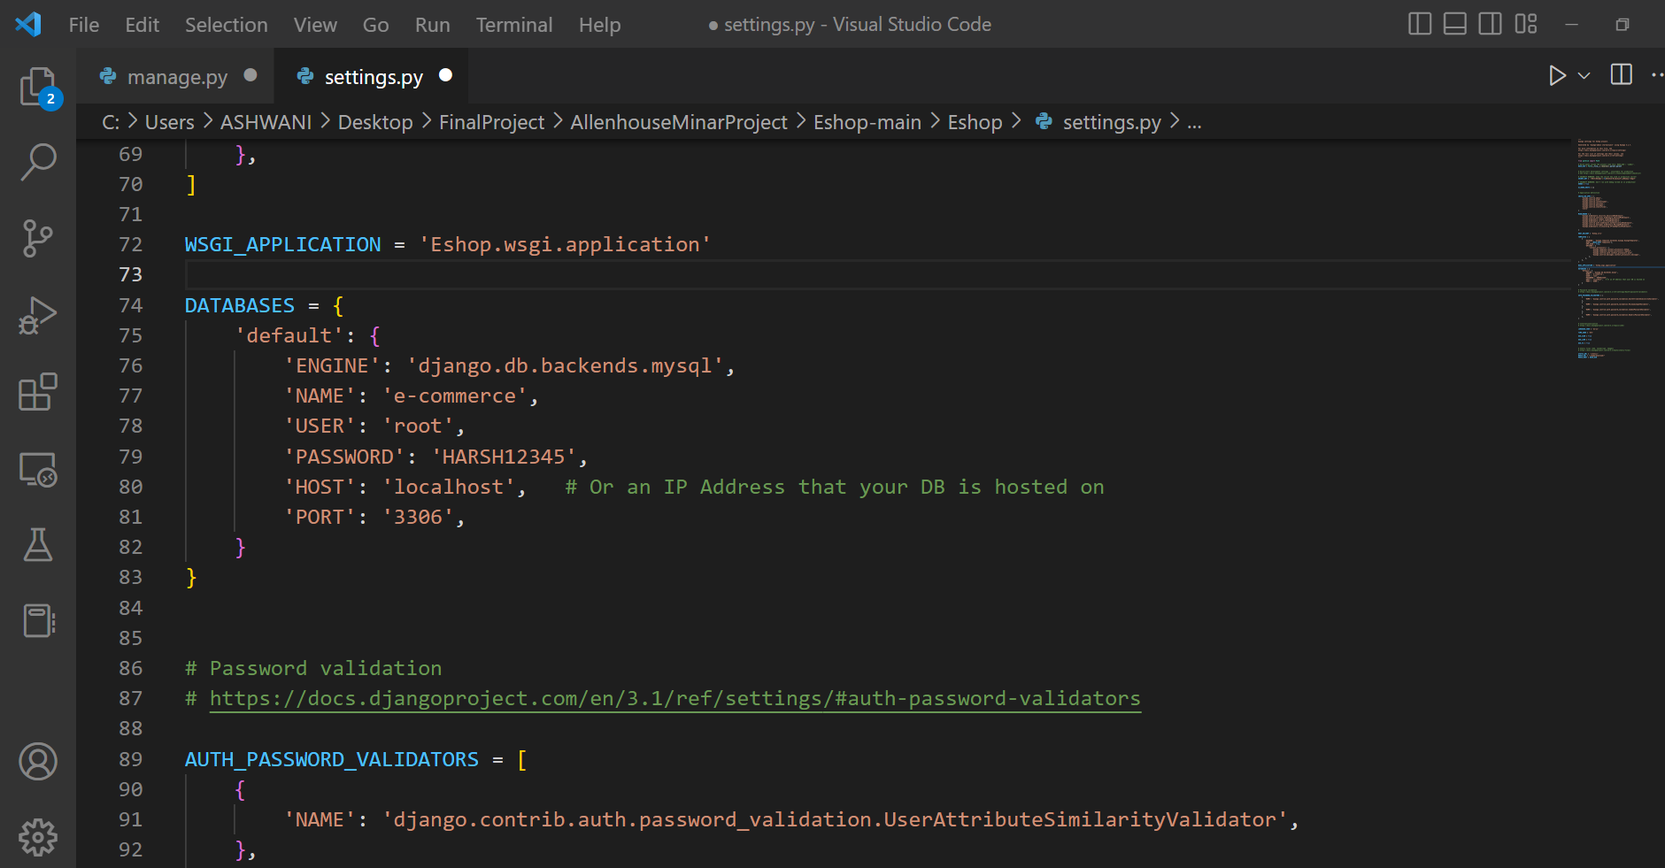
CODING

Slide 10
SCREENSHOT OF E-COMMERCE WEBSITE

Slide 11
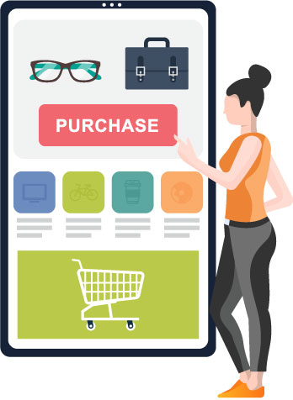

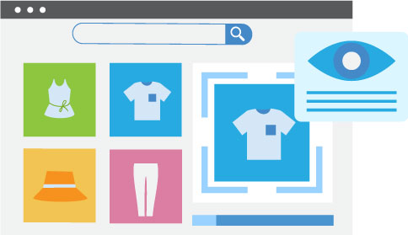
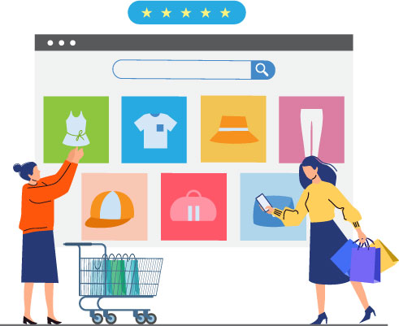
FUTURE SCOPE
Mobile-friendliness
Customer experience
Image recognition turned product recognition
Add multiple things like game, payment ,music etc

Slide 12
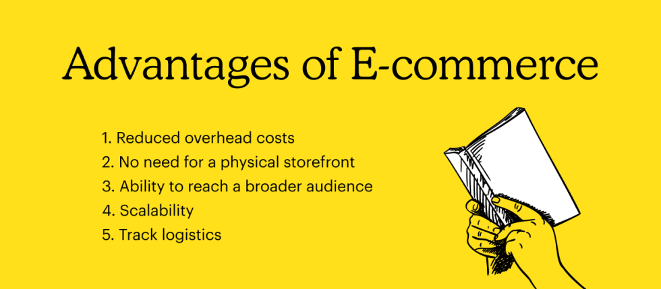
Advantages

Slide 13
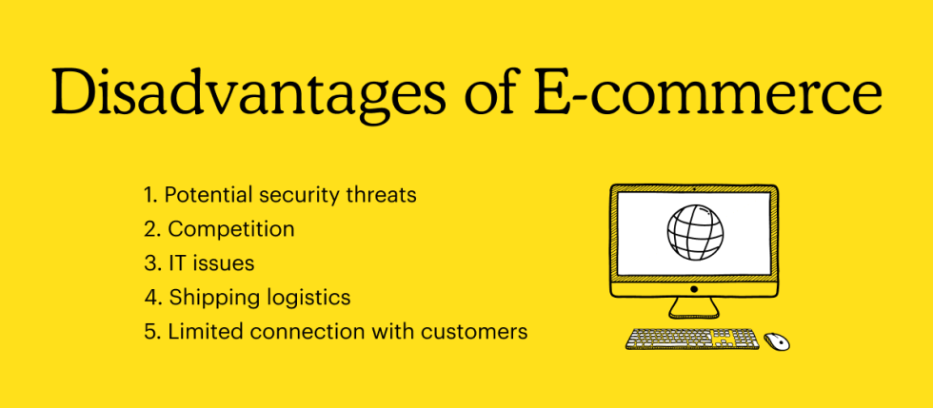
Disadvantages

Slide 14
CONCLUSION
E-commerce still represents one of the business methods that take advantage if done the right way, even if the stock market and commodities fell, but E-Commerce still able to survive and receive high transaction. In addition, it is also to introducing new techniques and styles in a transaction. Use the extensive E-Commerce in the Internet world is actually much better to bring the goodness of the individual or the state.

Slide 15
THANKYOU

